Slide 1
Requirements Engineering and Management Module 5 Refining the System Definition
Prof Alok Chauhan
VIT Chennai

Slide 2
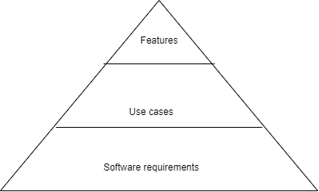
Software Requirements
Software Requirements
Look beyond features and use cases
System elements
System inputs
Content
Device details
Protocol
System outputs
Format
Device details
protocol

Slide 3
Software Requirements
System functions
Mapping(input) = output
System attributes
Non functional requirements
System environment attributes
Additional non-functional requirements
Not requirements
Project Information
Schedule
Budget
Tests
Design Information
Design/implementation
May be considered as design constraint

Slide 4
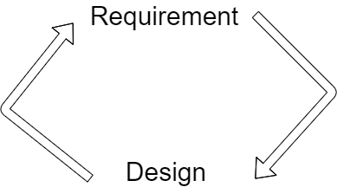
Requirements versus Design
What vs how
Users & customers vs technologists
Iterative process

Slide 5
Types of requirements
Functional software requirements
system behavior
inputs, outputs, functions
system action-oriented
captured in use cases
Nonfunctional software requirements
System attributes
system environment attributes
Design constraints
design limits of the system
external behavior of the system is not affected

Slide 6
Refining the Use Cases
Use case evolution
Expand use case further
use-case expansion is not system decomposition
refining a chain of actions rather than hierarchically breaking actions into subactions
May not be needed for simple use cases
Use case scope
To decide if a set of user interactions is one or several use cases

Slide 7
refinement process
Actors revision
Use case name revision
Use case description revision
Flow of events revision
Textually or other techniques such as UML interaction diagram
Note all alternative flows, including all possible error conditions
Bring in the testers who have expertise in identifying "non-happy day" flows.

Slide 8
Recognizing the Pre- and Post-conditions
are observable states
pre-condition is a constraint on beginning of a use case
Meant for whole use case and not for only one individual flow but may be declared at that level
post-condition for a use case should be true not only for the main flow but also for alternative flows as well
post-condition = use case output
use-case flow start event ≠ pre-condition

Slide 9
Recognizing Special Requirements
nonfunctional requirements such as usability, reliability, performance etc.
Recorded in supplementary specification

Slide 10
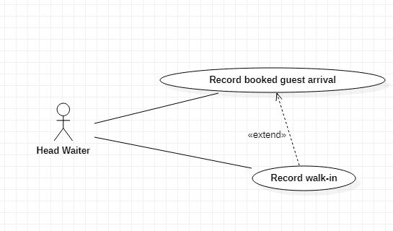
Extending Use Cases
extend an existing use case at the next release
Updation vs extension debate
Easy maintenance
Indicates future features
may represent an option rather than a new, basic, or alternative flow
indicate the extension points in the basic flow and the conditions (conditional guard)

Slide 11
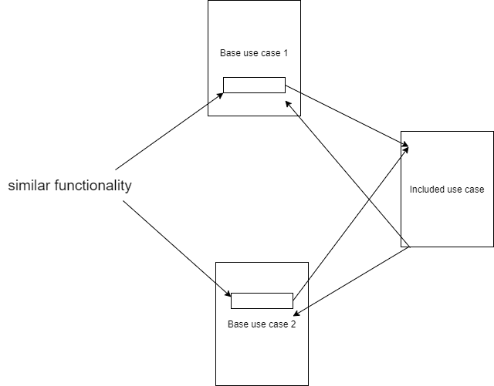
Including Use Cases in Other Use Cases
similar to a subroutine or include function in software
Include use case flow

Slide 12
Developing the Supplementary Specification
Role of the Supplementary Specification
requirements that can not be expressed in use case model , examples ??
80/20 rule for software requirements
Complex systems
Not much of externally visible functional behavior
Functional Requirements not expressible in the use case format (Supplementary Specification is main document)
algorithmic and computational systems
embedded-controls systems
state machines, logic expressions etc.
Language translators

Slide 13
Nonfunctional Requirements Categories
usability
reliability
performance
supportability

Slide 14
Usability
Usability/ease of use metrics and other features as requirements
training time (novice users, normal users, "power" users)
task times
Comparison with other state-of-the-art systems
Mentioning the existence and required features of various help materials
HCI standards
User's Bill of Rights

Slide 15
Reliability
Reliability expressed in terms of
Availability
Mean time between failures (MTBF)
Mean time to repair (MTTR)
Accuracy
defect rate (bugs/KLOC)
Bugs per type
"predictor" metrics
cyclomatic complexity

Slide 16
Performance
Performance expressed in terms of
Transaction response time(average, max)
Throughput (transactions/sec)
Capacity (the number of customers or transactions system can handle)
Modes of degradation
Hardware resource sharing with other systems

Slide 17
Supportability
ease of modification/enhancement/repair
Overlapping with design constraints

Slide 18
Design Constraints
Sources
design options restriction
Exclusion of options leads to restrictions
development process conditions
Compatibility issues
Application guidelines
Organizational best practices
regulations/standards
ISO
IEEE

Slide 19
Handling Design Constraints
Differentiate from other requirements
Create separate section for them in document
Source identification
Justification
Are Design Constraints True Requirements?

Slide 20
Other Requirements
Physical deliverables of the system
configuration and initialization requirements
training requirements
Internationalization and localization requirements

Slide 21
Connecting Supplementary Specification and Use Cases
by defining certain classes of nonfunctional requirements

Slide 22
Supplementary Specification contents
Introduction
Functional requirements
Not included in use case model
Usability
Reliability
Performance
Supportability
Design constraints
Documentation requirements
Purchased components

Slide 23
Supplementary Specification contents
Interfaces
User
Hardware
Software
Communication
Licensing and security
Legal, copyright and other notices
Applicable standards
Internationalization and localization
Physical deliverables
Installation and deployment

Slide 24
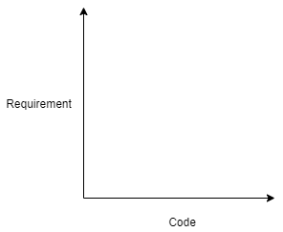
Building the Right System -Use Cases to Implementation
Mapping Requirements to Design and Code
Direct mapping only for some requirements
design of the solution does not follow the form of the requirements
Orthogonality Problem
Requirement vs code, different languages

Slide 25
Use Cases to Implementation
Orthogonality Problem
Logical structure vs process structure (performance requirements)
Part vs whole
Reuse (design optimization)
Object Oriented Analysis & Design
Takes care of orthogonality problem to some extent
Be aware of non-OO architecture
Use Case as a Requirement
Helpful in dealing with orthogonality problem

Slide 26
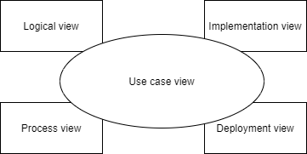
Use Cases to Implementation
Looking at the problem of orthoganality in terms of software architecture
4+1 view of architecture
Confirms the importance of use case model

Slide 27
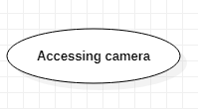

Use Cases to Implementation
Use Cases realization in the Design Model
use-case-driven design
use case realization = collaboration
Collaboration
<<trace>>
Accessing camera

Slide 28
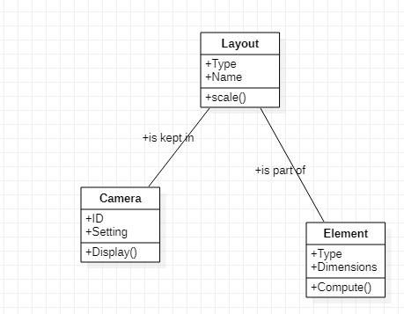
Use Cases to Implementation
Collaboration
Structural (Class diagram)
Behavioral (Sequence diagram)

Slide 29
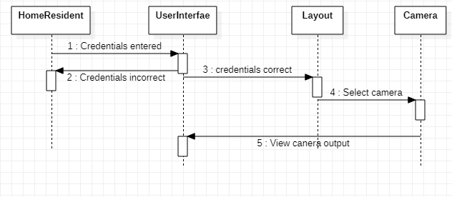
Sequence diagram
Use Cases to Implementation

Slide 30
Use Cases to Implementation
Realization of sets of individual requirements through collaborations
Requirement 1
Requirement 2
Requirement 3
Non functional requirements may be traced similarly to collaborations
Collaboration
<<trace>>

Slide 31
Use Cases to Implementation
Design to Implementation
Iterative refinement of design models
implementation in terms of
source files
binaries
executables
Others
Design to implementation mapping may not be direct due to componentization
Architectural view concept (4+1) should be utilized to link requirements to design to implementation

Slide 32
Use Cases to Test Cases
system testing
From the perspective of tester
System as a big black box
use-case technique provides necessary artifacts such as use case model and supplementary specification that can directly drive the testing process
Traditional non-use-case-driven development process (implication for testing ?)

Slide 33
Use Cases to Test Cases
Use case ≠ test case
Generating Test Cases from Use Cases
Recognizing Use-Case Scenarios
With the help of scenario matrix
Scenario # | Originating flow | Alternate flow | Next alternate | …….

Slide 34
Use Cases to Test Cases
Recognizing Test Cases for each scenario
Recognizing Test Conditions
Adding Data Values
Test case ID | Scenario/condition | Data value 1 | Data value 2 | Data value N | Expected result | Actual result
Test case matrix

Slide 35
Use Cases to Test Cases
Manage test coverage
Exhaustive testing is costly
Test critical use cases thoroughly
Use case testing is basically black-box testing
White-box testing = use case realization/collaboration testing = static part (class diagram) review + dynamic part (sequence diagram) inspection/execution testing

Slide 36
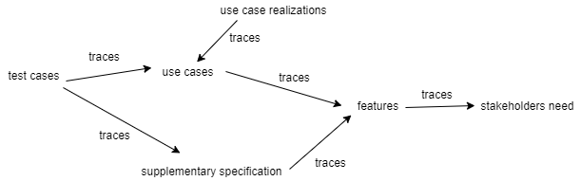
Tracing Requirements
Trace(Requirements→specification→architecture→design→ implementation → testing) = quality software implementation
Traceability hierarchy

Slide 37
Tracing Requirements
requirement-to-requirement traceability
Traceability Matrix (scan row/column for errors)
User Needs versus Features
Features versus Use Cases
Features/system requirements versus Supplementary Requirements
Tracing Requirements to Implementation
Tracing from use case to use-case realization √
Tracing from use-case realization to implementation (classes) √
Direct tracing from requirement to code not recommended (due to problem of orthogonality) ×

Slide 38
Tracing Requirements
Tracing from supplementary requirements into implementation
trace individual requirements or groups of requirements to a collaboration
trace to the specific code contained in the classes that realize the collaboration
Tracing use cases to test cases
Tracing use cases to test case scenarios
Traceability Matrix for Use Cases to Scenarios
Tracing scenarios to test cases
Traceability Matrix for Use Cases to Test Cases

Slide 39
Tracing Requirements
Tracing from Supplementary Requirements to Test Cases
trace individual requirements or groups of requirements to scenarios and test cases

Slide 40
Traceability Tools
Needed for larger projects
For smaller projects spreadsheet or database may be used for traceability but would be difficult to use

